Slide 1

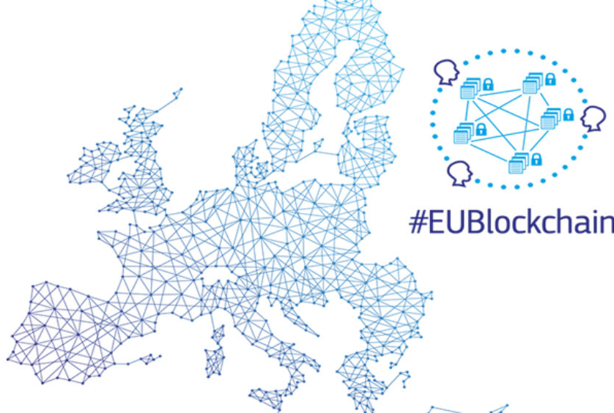
Personal Data Wallet
“It’s me”
“I am like this”
“I can do this”
Off-chain
Privacy-preserving (GRPR)
Simple and very efficient
Credentials
Attests something about somebody
Proves something to somebody
Trusted parties
Service provider
Status
Status
Status
Notes:
But all the use cases have a thing in common: they need a new Identity system for natural and juridical persons and also for things and processes.
This is where the new Self-Sovereign Identity coming from EBSI enters.
By the way, this is also a type of Notarization. There is no exchange of value, but proof of existence of something in the past.

Slide 2
EBSI
Check status
Trusted parties
Service provider
Credentials
The Service Provider can be any entity in any part of the world
It requires:
Trust on the onboarding process of entities in the source blockchain
A trusted API to query the public key signing the credential and the status of the credential (not revoked)
Notes:
But all the use cases have a thing in common: they need a new Identity system for natural and juridical persons and also for things and processes.
This is where the new Self-Sovereign Identity coming from EBSI enters.
By the way, this is also a type of Notarization. There is no exchange of value, but proof of existence of something in the past.

Slide 3
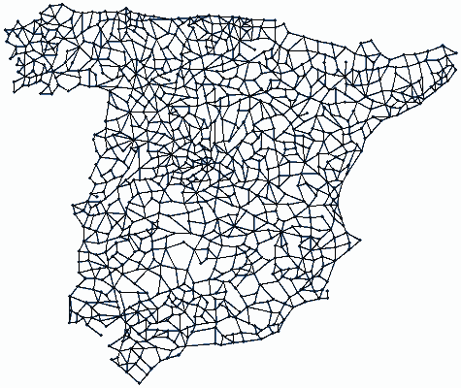

EBSI
Check status
Trusted parties
Service provider
Credentials
Service provider
Trusted parties
Check status
Notes:
But all the use cases have a thing in common: they need a new Identity system for natural and juridical persons and also for things and processes.
This is where the new Self-Sovereign Identity coming from EBSI enters.
By the way, this is also a type of Notarization. There is no exchange of value, but proof of existence of something in the past.

Slide 4

Issuers
Issuers
Verifiers
Verifiers
Verifiable
Credentials
Issuers
Verifiers
Notes:
But all the use cases have a thing in common: they need a new Identity system for natural and juridical persons and also for things and processes.
This is where the new Self-Sovereign Identity coming from EBSI enters.
By the way, this is also a type of Notarization. There is no exchange of value, but proof of existence of something in the past.

